Slide 1
RCRA REQUIREMENTS THE QUICK VERSION
Presented by : John Dotterweich
Environmental Scientist 2
Division of Waste Enforcement, Pesticides & Release Prevention
(609) 439- 9726
John.Dotterweich@dep.nj.gov

Slide 2
Weblinks
General rule information:
https://www.epa.gov/hwgenerators/final-rule-hazardous-waste-generator-improvements
Rule as posted in the Federal Register:
https://www.federalregister.gov/documents/2016/11/28/2016-27429/hazardous-waste-generator-improvements-rule

Slide 3
Weblinks
Fact sheet:
https://www.epa.gov/hwgenerators/fact-sheet-about-hazardous-waste-generator-improvements-final-rule
Frequently Asked Questions:
https://www.epa.gov/hwgenerators/frequent-questions-about-hazardous-waste-generator-improvements-final-rule

Slide 4
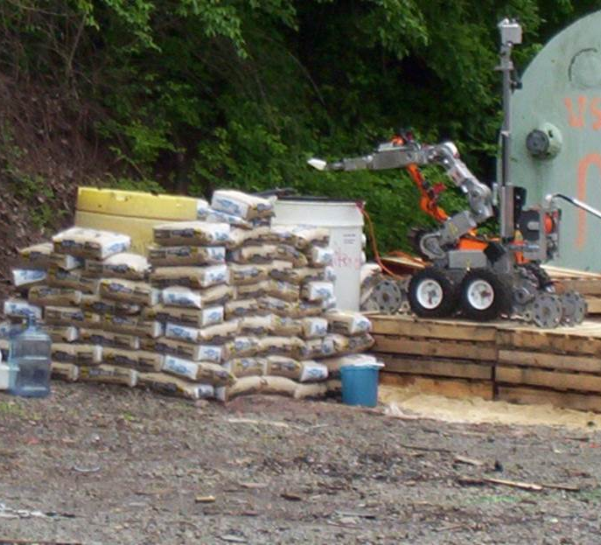
RCRA REQUIREMENTS THE QUICK VERSION
Waste Determination
40 C.F.R. 262.11 – Already discussed
Determining Generator Category
40 C.F.R. 262.13 – Already discussed

Slide 5
RCRA REQUIREMENTS THE QUICK VERSION
VSQGs
40 C.F.R. 262.14
Was CESQG
Conditional Exemption
Still a conditional exemption
Now Very Small Quantity Generator
Violate rules and lose exemption

Slide 6
RCRA REQUIREMENTS THE QUICK VERSION
Satellite Accumulation
40 C.F.R. 262.15 – Already discussed in Waste Management

Slide 7
RCRA REQUIREMENTS THE QUICK VERSION
Preparedness Prevention - Satellite Areas
SQG’s must meet Preparedness and Prevention at 262.16(b)(8) and Emergency Procedures at 262.16(b)(9).
LQG’s must meet the Preparedness, Prevention and Emergency Procedures at subpart M of 262

Slide 8
RCRA REQUIREMENTS THE QUICK VERSION
Preparedness and Prevention - SQGs
262.16(b)(8)(i): Minimizing possibility of a fire, explosion, or any release
262.16(b)(8)(ii): Equipping facility with emergency equipment
262.16(b)(8)(iii): Testing and maintaining emergency equipment

Slide 9
RCRA REQUIREMENTS THE QUICK VERSION
Preparedness and Prevention – SQGs
262.16(b)(8)(iv): Immediate access to communications or alarm system
262.16(b)(8)(v): Aisle space
262.16(b)(8)(vi): Arrangements with PD, FD, Contractors, Hospitals etc.

Slide 10
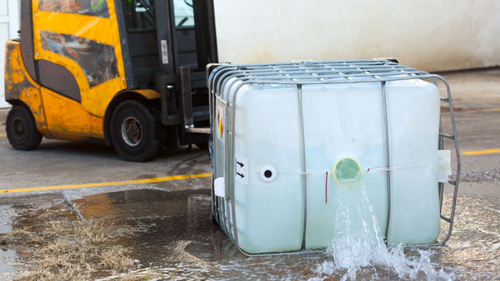
RCRA REQUIREMENTS THE QUICK VERSION
Emergency Procedures – SQGs
262.16(b)(9)(i): Emergency coordinator
262.16(b)(9)(ii): Post emergency information
262.16(b)(9)(iii): Train employees on waste handling/emergency procedures
262.16(b)(9)(iv): Respond to emergencies

Slide 11
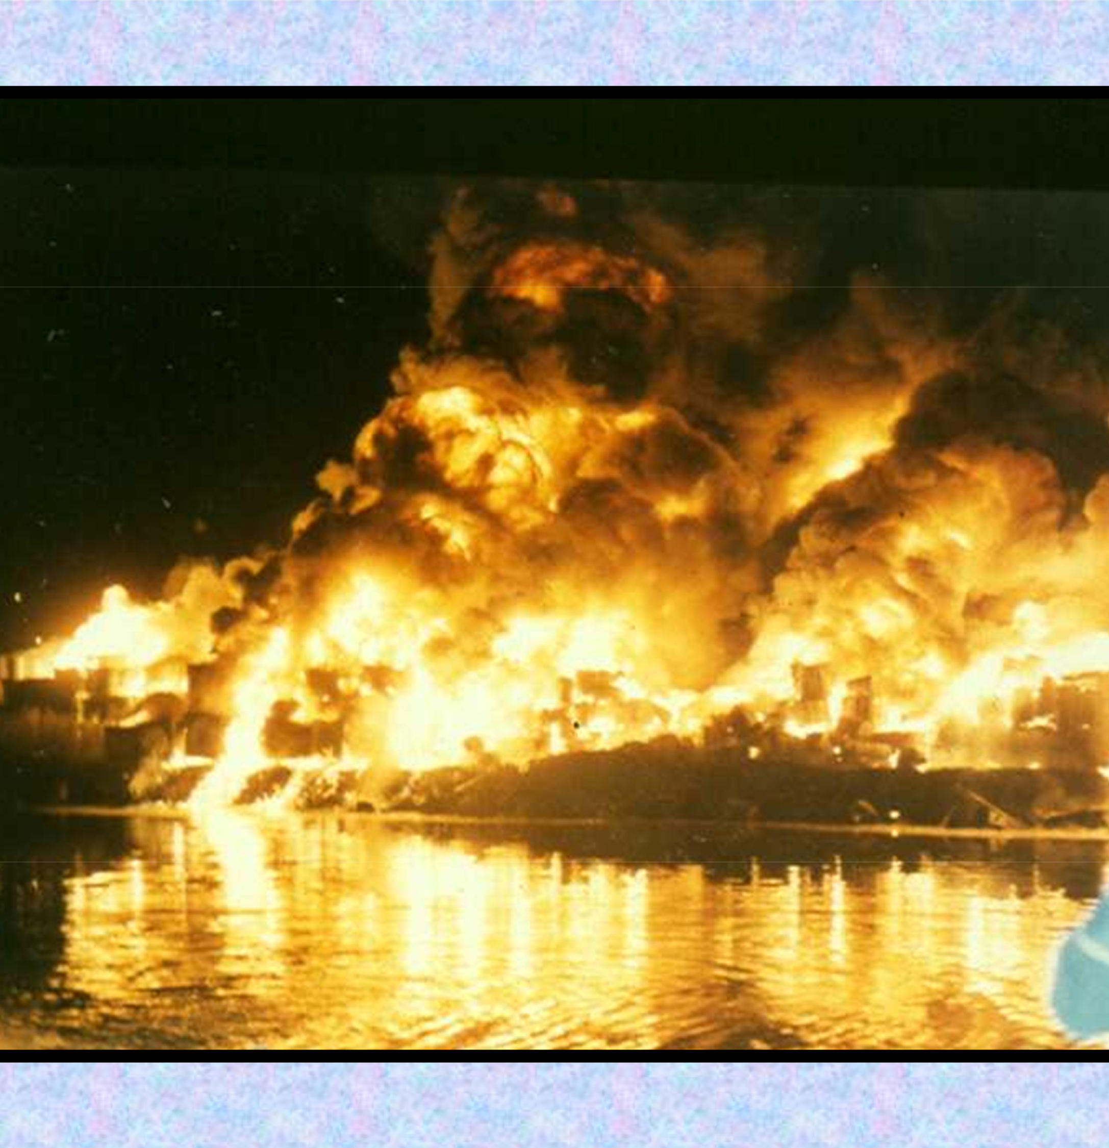
RCRA REQUIREMENTS THE QUICK VERSION
Subpart M – P&P at LQGs
262.251: Minimizing possibility of a fire, explosion, or any release
262.252: Equipping facility with emergency equipment
262.253: Testing and maintaining emergency equipment

Slide 12
RCRA REQUIREMENTS THE QUICK VERSION
Subpart M – P&P at LQGs
262.254: Access to communications or alarm system
262.255: Aisle space
262.256: Arrangements with PD, FD, Contractors, Hospitals

Slide 13
RCRA REQUIREMENTS THE QUICK VERSION
Subpart M – P&P at LQGs
262.260 - 262: Contingency Plans
262.262: Quick Reference Guide
262.263 - 265: Emergency Coordinator

Slide 14
RCRA REQUIREMENTS THE QUICK VERSION
General SQG Requirements
262.16(b)(2): Containers
262.16(b)(3): Tanks
262.16(b)(4): Drip Pads
262.16(b)(5): Containment Buildings
262.16(b)(6): Labeling/Marking
262.16(b)(8): P&P
262.16(b)(9): Emergency Procedures

Slide 15
RCRA REQUIREMENTS THE QUICK VERSION
General LQG Requirements
262.17(a)(1): Containers
265 Subpart J: Tanks 262.17(a)(3): Drip Pads
262.17(a)(4): Containment Buildings
262.17(a)(5): Labeling/Marking

Slide 16
RCRA REQUIREMENTS THE QUICK VERSION
General LQG Requirements
262.17(a)(7): Personnel Training
262.17(a)(8): Closure
262.17(c): F006 Waste
262.17(f) and (g): Waste from VSQGs

Slide 17
RCRA REQUIREMENTS THE QUICK VERSION
EPA ID Numbers and Renotification
262.18(a) – (e)
262.18(a): Generator must have EPA ID Number
262.18(c): Only offer hazardous waste to Transporters/TSDs with EPA ID Number

Slide 18
RCRA REQUIREMENTS THE QUICK VERSION
SQG Renotification
262.18(d)1
SQGs must re-notify starting in 2021
Every four years thereafter
Use EPA Form 8700-12
By September 1st of each year when re-notification required

Slide 19
RCRA REQUIREMENTS THE QUICK VERSION
LQG Renotification
262.18(d)2
LQGs must re-notify by March 1 of each even-numbered
Use EPA Form 8700-12
May submit re-notification as part of Biennial Report

Slide 20
RCRA REQUIREMENTS THE QUICK VERSION
Episodic Events
262.232(a) SQG Requirements
262.232(b) LQG Requirements

